Slide 1
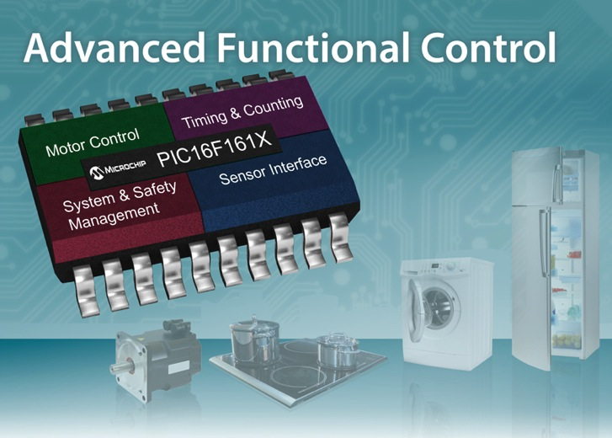
Announcing the
PIC16(L)F161X 8-bit MCUs
November 11, 2014

Slide 2
PIC16(L)F161X
Closed Loop control and Safety-Monitoring
with Core Independent Peripherals
Advanced Digital and Analog Integration in a Small Form Factor
  Family contains 6 product with up to 14KB of Flash and 1KB of RAM
  8-, 14- and 20-pin packages
  10-bit ADC (up to 28 ch), 8-bit DAC, 2x Comparators, 2 x 10-bit PWMs
New Core Independent Peripherals that Empower Functional Enablement
  Angular Timer (AngTmr)
  Math Accelerator (MathACC)
  2 x High Current I/Os (100 mA)
  Peripheral Pin Select (PPS)
Additional Core Independent Peripherals
  Up to 4 Configurable Logic Cells (CLCs)
  2 x 24-bit Signal Measurement Timers (SMTs)
  Windowed Watchdog Timer (WWDT)
  Cyclic Redundancy Check with Memory Scan (CRC/SCAN)
  3 x Hardware Limit Timers (HLTs) and Zero Cross Detect (ZCD)
  Complementary Waveform Generator (CWG)
  Up to 4 Configurable Logic Cell (CLC)
  High Endurance Flash (HEF) (Non-volatile Data Storage)
Feature eXtreme Low Power Technology
  Sleep Current 20nA
  Active Current 29uA / MHz
Notes:
This was done based on the feedback from a lighting vendors…
Comparator is 50ns
2

Slide 3
PIC16(L)F161X
Closed Loop control and Safety-Monitoring
with Core Independent Peripherals
  Reduced Code Complexity, Interrupt Latency, and Power Consumption
  with Increased Core Performance
  MATH Accelerator (MathACC)
    Complete Core Independent calculations, with the capability to perform 16-bit math and PID operations
    Speeds math functions by performing tasks in hardware
  Angular Timer (AngTMR)
    Phase angle timer, measurement and control of rotational and periodic events
      Motor control, TRIAC or Capacitive Discharge Ignition (CDI) system
    Allows recurring interrupts at a specific rotational or sinusoidal angle with no software setup hassles
  Two High Current I/Os (100 mA)
    Eliminates the need for an external driver
  Peripheral Pin Select (PPS)
    I/O pin remapping of any digital peripheral
2
NEW CIPs
Notes:
3

Slide 4
PIC16(L)F161X
Closed Loop control and Safety-Monitoring
with Core Independent Peripherals
  Eases Implementation of System Functions into New or Existing Designs
  Two 24-bit Signal Measurement Timers (SMT)
    High-resolution signal measurement
    Independent from the core; allows the CPU to perform other complex tasks
      Eliminates Interrupts Latency
      Frees up Core to perform other Tasks
      Lowers power
  Complementary Waveform Generator (CWG)
    Simplifies drive control of motors and power supplies
  Zero Cross Detect (ZCD)
    Senses when AC signal crosses zero
    Limits the need for additional components, simplifying TRIAC control
  Simplifies Implementation of Safety Standards, e.g. UL & Class B
  Cyclic Redundancy Check with Memory Scan (CRC/SCAN)
    An error-detection module available to memory and communications peripherals
  Windowed Watchdog Timer (WWDT)
    Monitors “overrun” and “under run” events in software timing
  Three Hardware Limit Timers (HLTs)
    Monitor hardware for fault conditions (stalls, stops, etc.); ideal for closed-loop control applications
Notes:
4

Slide 5

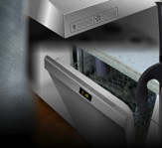







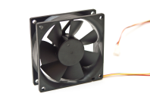
PIC16F(L)161X
Target End Equipment & Functions
Motor Control
BLDC
Brushed DC
AC Induction
Home Appliance
Washers & Dryers
Dishwashers
Refrigerators
Industrial & Automotive
System Monitoring
Fail-Safe Protection
Sensor Interfaces
TRIAC-Based Applications
Dimming Control
Blenders / Small Appliances
General-Purpose Functions
Power-Supply Control
Fan Control

Slide 6
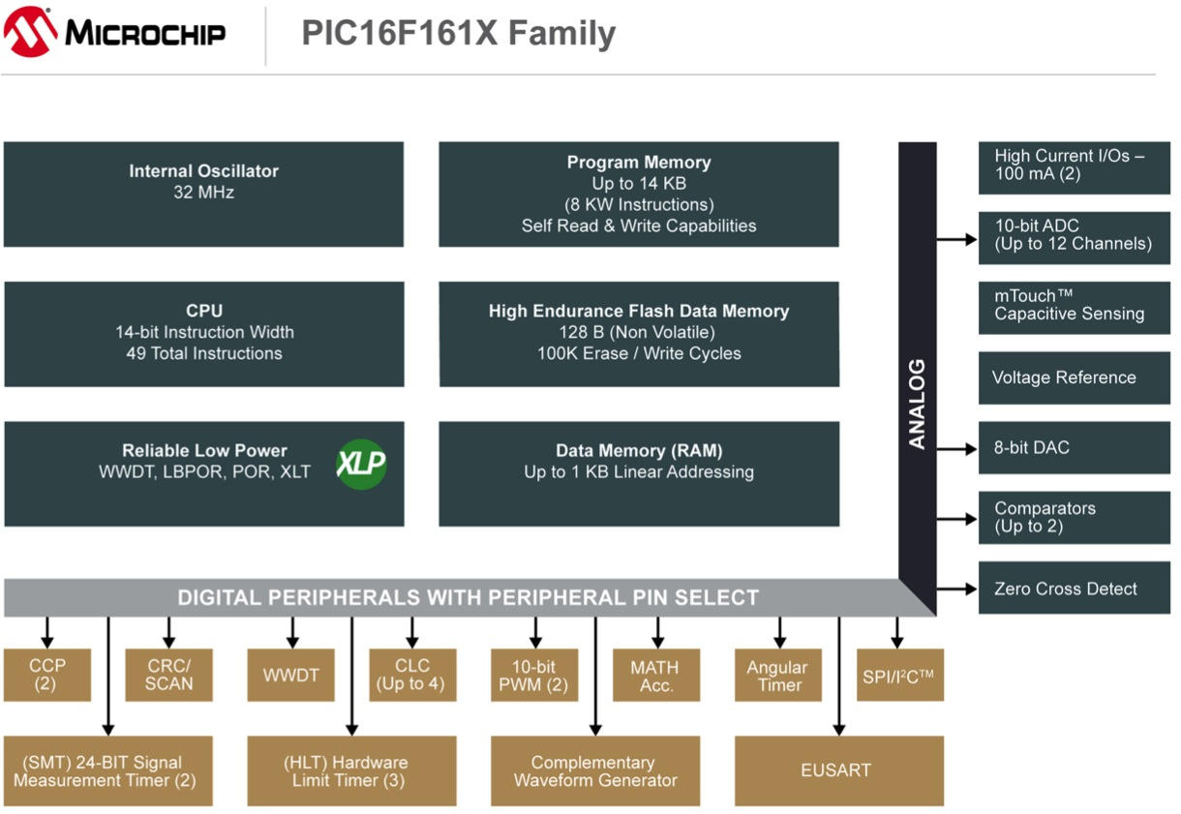
PIC16(L)F161X
Block Diagram

Slide 7
Function Enablement
Flexible Peripheral Integration
Motor Control Functionality Highlights
Hardware PID control:
Simplified rotational speed and position control
Automated complementary waveform generation
100 mA drive capability
Application Functions
PIC16(L)F161X
Motor Control
CPU
Memory
System & Safety Management
ADC
Capture Compare PWM
Configurable
Logic Cell
High Endurance
Flash (Data)
Output & Signal Generation
Comparators
Complementary Waveform Generator
Math
Accelerator
Peripheral Pin
Select
Input & Sensor Interface
DAC
10b PWM
Angular Timer
eXtreme Low Power
XLP Technology
System Communications
Timing & Counting
Voltage
Reference
Cyclical
Redundancy Check
Signal
Measurement Timer
mTouch®
Human Interface
Zero Cross
Detect
Hardware
Limit Timer
TEMP Indicator
EUSART/LIN
Custom Functions
High Current
100 mA I/O
Windowed WDT
8/16/20/24-bit
Timers
I²C™/SPI

Slide 8
Function Enablement
Flexible Peripheral Integration
System & Safety Management Functionality Highlights
Automated corruption detection of memory & communication data
Monitoring of missed events & fault detection of external hardware
Flexible peripheral pin mapping
Customizable system monitoring functions
Application Functions
PIC16(L)F161X
Motor Control
CPU
Memory
System & Safety Management
ADC
Capture Compare
PWM
Configurable
Logic Cell
High Endurance
Flash (Data)
Output & Signal Generation
Comparators
Complementary
Waveform Generator
Math
Accelerator
Peripheral Pin
Select
Input & Sensor Interface
DAC
10b PWM
Angular Timer
eXtreme Low Power
XLP Technology
System Communications
Timing & Counting
Voltage
Reference
Cyclical
Redundancy Check
Signal
Measurement Timer
mTouch®
Human Interface
Zero Cross
Detect
Hardware
Limit Timer
TEMP Indicator
EUSART/LIN
Custom Functions
High Current
100 mA I/O
Windowed WDT
8/16/20/24-bit
Timers
I²C™/SPI

Slide 9
Function Enablement
Flexible Peripheral Integration
Timing & Counting Functionality Highlights
Phase angle timer for rotational and periodic events
Hardware fail-safe monitoring
Detection of software timing anomalies within critical window
Up to 24-bit measurement of any digital signal
Application Functions
PIC16(L)F161X
Motor Control
CPU
Memory
System & Safety Management
ADC
Capture Compare
PWM
Configurable
Logic Cell
High Endurance
Flash (Data)
Output & Signal Generation
Comparators
Complementary
Waveform Generator
Math
Accelerator
Peripheral Pin
Select
Input & Sensor Interface
DAC
10b PWM
Angular Timer
eXtreme Low Power
XLP Technology
System Communications
Timing & Counting
Voltage
Reference
Cyclical
Redundancy Check
Signal
Measurement Timer
mTouch®
Human Interface
Zero Cross
Detect
Hardware
Limit Timer
TEMP Indicator
EUSART/LIN
Custom Functions
High Current
100 mA I/O
Windowed WDT
8/16/20/24-bit
Timers
I²C™/SPI

Slide 10
Function Enablement
8-bit PIC® Microcontrollers
CPU
Memory
Motor Control
Sensor & Signal Interface
Motor
Angular Timer
Environmental Sensors
Capture Compare PWM
ADC
TEMP Indicator
10b/16b PWM
Configurable
Logic Cell
DAC
Math
Accelerator
TRIAC Control
TRIAC
Monitoring
Complementary Output Generator
10b/16b PWM
Signal Measurement Timer
Hardware Limit Timer
High Current
100mA
Zero Cross Detect
AC Power
Zero Cross Detect
System & Safety Management
Cyclical Redundancy Check
Windowed WDT
XLP Technology
PPS

Slide 11
Advantages of
Core Independent Peripherals
Math Accelerator (MathACC)
  General purpose MATH & PID functions
  MULTIPLY, ADD, ACCUMULATE functions
    8-bit/16-bit values with 35-bit result
  Four Operation Modes
    Multiply and Accumulate (MAC)
    Add and Multiply
    Simple Multiplier
      Signed & un-signed multiplies
    Programmable PID Controller
      16-bit PID function based on configurable Kp, Ki, Kd constants with a 34-bit result
Running a PID Loop
75 μs
Execution Time
(Instruction cycles) @16 MHz
1.75 μs
~300
Instruction Cycles
7
Instruction Cycles
Benefits
  Speeds up math performance
  Reduces code size
  Accelerates PID control
  Core independent operation
W/O
MathACC
MathACC
Notes:
11

Slide 12
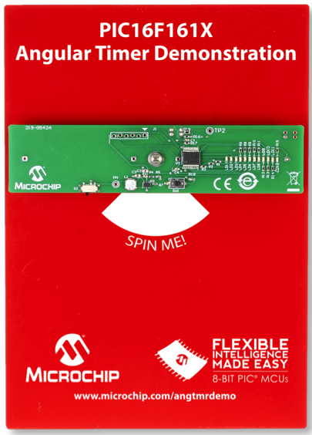
  Angular Timer
  Demonstration Platform
PIC16F161X Angular Timer Demonstration
The PIC® MCU uses its on-chip Angular Timer to maintain a precise and consistent location for the displayed image, making automatic adjustments as the propeller slows to a halt.
Angular Timer offers a latency-free way to identify any angle-of-rotation, regardless of speed or acceleration.
Hardware-based solution reduces power consumption, increases system performance, and frees the CPU to perform the task of driving the LED array.
PIC16F1619 Controlled
  Uses integrated peripherals, including:
    Angular Timer – Timing measurement
    ADC – Sensor
    I/O Pins – Driving LEDs directly
  Sensor
    Initiates timing activities
  12 – LEDS
Powered via:
2 x AAA
www.microchip.com/angtmrdemo

Slide 13
Advantages of
Core Independent Peripherals
225 μs
Off-loading from the CPU
  Reduces instruction cycles
  Core independent operation
  Cycle Ratio: ~300 to 1 CPU instructions
Improving Performance
  Increases accurate measurements
  Simplifying Design
~900
Instruction
Cycles
Execution Time
(Instruction cycles)
0.75 μs
3
Instruction Cycles
W/O
Angular Tmr
Angular Tmr
Math
LED
Math
LED
CPU – w/o AngTmr
98%
Cycle Time SAVING
CPU – w/AngTmr
Free
LED
Free
LED
Cycle Time
Notes:
w/o angular tmr: length of instruction is because 16-bit/DIV
13

Slide 14
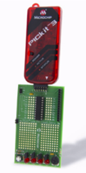
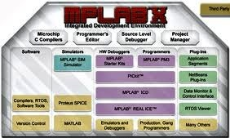
PIC16(L)F161X
Development Tools
Development Board
  PICkit™ 3 Starter Kit (DV164130)
  8-bit Low Pin Count Dev Kit (DM164130-9)
  Programmer / Debuggers / IDE / Compiler
  PICkit 3 (PG164130) MPLAB® ICD3 (DV164035)
  MPLAB PM 3 (DV007004)
  MPLAB X IDE / XC8 Compiler
MPLAB® Code Configurator: (available in 2.10: expected Dec’14)
Generates seamless, easy to understand Drivers and Initializers that can be inserted into your project
  Enables, configures and utilizes a rich set of peripherals across many of Microchip’s most popular PIC® microcontrollers
  Generated C code can be easily modified and debugged
Leverage drivers and GUI interface to reduce time to market
Powerful, easy to use plug-in development tool for MPLAB X IDE
Download this powerful development tool for FREE at:
www.microchip.com/MCC
  PICkit 3 Starter Kit (DV164130)

Slide 15
PIC16(L)F161X
Summary
Key Differentiators: Core Independent Peripherals
  Offloads work from the CPU, work is done in hardware
  Eliminates Interrupt Latency in time critical tasks
  Lower System Power Consumption
  Reduce Design Complexity
  Can perform multiple functions simultaneously
Strengths of Our Solution
  Math Accelerator w/PID (MathACC)
  Angular Timer (AngTMR)
  High Current IOs – 100 mA
  Safety-Critical hardware features (WWDT, CRC/SCAN & HLT)
  Variety of unique Timers (WWDT, HLT, SMT)
  Zero Cross Detect (ZCD)
  Integration of Analog reduces design errors and complexity
  Functions can be combined for simultaneous execution
Feature eXtreme Low Power Technology

Slide 16
Thank you!
Note: The Microchip name and logo, PIC, MPLAB and mTouch are registered trademarks of Microchip Technology Incorporated in the U.S.A., and other countries. All are trademark of Microchip Technology Inc. in the U.S.A., and other countries. All other trademarks mentioned herein are the property of their respective companies.

Slide 17
PIC16(L)F161X
Back-up

Slide 18
PIC16(L)F161X
eXtreme Low Power 8-bit MCUs with Core Independent Peripherals
PIC16F1615
14KB / HEF / 1KB
4xCLC
PIC16F1619
14KB / HEF / 1KB
4xCLC
PIC16F1614
7KB / HEF / 512B
8x10b ADC, 8b DAC, 2xComp, 2xCCP, 2xPWM, CWG, 3x16TMR, 3xHLT, 2xSMT, AngTMR, WWDT, CRC/SCAN, MathACC, 2xCLC, ZCD, PPS, 2x100mA I/O, SPI/I²C, EUSART
PIC16F1618
7KB / HEF / 512B
12x10b ADC, 8b DAC, 2xComp, 2xCCP, 2xPWM, CWG, 3x16TMR, 3xHLT, 2xSMT, AngTMR, WWDT, CRC/SCAN, MathACC, 2xCLC, ZCD, PPS, 2x100mA I/O, SPI/I²C, EUSART
Features/Memory
PIC12F1612
3.5KB / HEF / 256B
4x10b ADC, 8b DAC, Comp, 2xCCP, CWG,
3xHLT, 2xSMT, WWDT, CRC/SCAN, ZCD
PIC16F1613
3.5KB / HEF / 256B
8x10b ADC, 8b DAC, 2xComp, 2xCCP, CWG,
3xHLT, 2xSMT, WWDT, CRC/SCAN, ZCD
8-pin
14-pin
20-pin
Notes:
18
18

Slide 19
PIC16(L)F161X
Pricing and Availability
Pricing:
  10ku Pricing Starting at $0.53 each
Packages:
  8 pin – PIC12(L)F1612
    PDIP, SOIC, DFN, UDFN
  14 pin – PIC16(L)F1613, 16(L)F1614 & 16(L)F1615
    PDIP, SOIC, TSSOP, QFN, UQFN
  20 pin – PIC16(L)F1618 & 16(L)F1619
    PDIP, SOIC, SSOP, QFN,UQFN
Availability:
  PIC16F161X variants samples Now and Volume in Jan’15
www.microchip.com/PIC16F161X

Slide 20
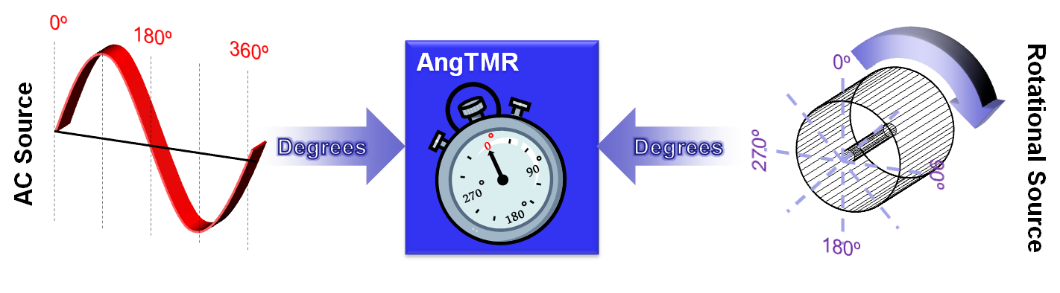
Angular Timer
Automatically Converts Timed-Based Events to Degrees
Angular Timer (AngTMR)
  Automatically provides phase angle conversion for control of rotational & periodic events
    e.g. Motor, AC Mains, TRIAC, etc.
  Converts time-based signals to degrees
  Generates interrupts based on angles
  Detects missed events
  Simplified code development
    Program in terms of degrees
    Automatically adjusts for frequency changes
    Simplifies math required
Benefits
  Increased accuracy
  Improved performance
  Reduced code size
  Core-independent operation
  Operation while in low power SLEEP
Example Uses
  Motors (Electric & Internal Combustion)
  Dishwashers
  Washer & Dryers
  Blenders
  Lighting
Notes:
20
20

Slide 21
Math Accelerator
Hardware Accelerated Math Functions
Math Accelerator (MathACC)
  General-purpose MATH & PID functions
  MULTIPLY, ADD, ACCUMULATE functions
    8-bit/16-bit values with 35-bit result
  Four Operation Modes
    Multiply and Accumulate (MAC)
    Add and Multiply
    Simple Multiplier
      Signed & un-signed multiplies
    Programmable PID Controller
      16-bit PID function based on configurable Kp, Ki, Kd constants with a 34-bit result
Benefits
  Speeds up math performance
  Reduces code size
  Accelerates PID control
  Core-independent operation
Example Uses
  Motor control
  Digital filter
  Sensor & temperature control
8-/16-bit Value
MathACC
a → a + (b x c)
a + b
a x (-b)
MAC
34-/35-bit Result
K_{p}e(t) + K_{i} ∫^{t} e(T)dT + K_{d} d/dt e(t)
8-/16-bit Value
a → a + (b x c)
a + b
a x (-b)
PID
K_{p}e(t) + K_{i} ∫^{t} e(T)dT + K_{d} d/dt e(t)

Slide 22
Cyclical Redundancy Check & Scan
Data Integrity Monitoring for Fault Detection
Cyclical Redundancy Check /Scan (CRC/SCAN)
  General purpose 2-bit to 16-bit CRC
    For use with memory and communications data
  Automated CRC checksum with background SCAN
    Program memory
    DataEE memory
  Calculates CRC checksum on communications data
  Configurable polynomial (all standard CRC implementations)
  Corruption is detected upon checksum mismatch
  All memory-scan operations are controlled via software
Benefits
  Increased code & data integrity
  Software configurable for easy updates & modifications
  Eases implementation of safety standards (e.g. Class B, UL, etc.)
  Core independent operation
  Operation while in low power SLEEP
Example Uses
  Dishwashers
  Ovens / Microwaves
  Laundry Equipment
  Data logging integrity
SCAN
Memory
Address
Communications
Data
CRC
Data
Checksum
Notes:
22
22

Slide 23
Windowed Watch Dog Timer
System Supervisory Circuit
Windowed Watch Dog Timer (WWDT)
  Detects software timing anomalies within a configurable critical window
  Supports standard watch dog timer functions
  Resets the CPU if…
    the WWDT overflows (standard WDT function)
    the WWDT underflows
Benefits
  Monitors timing-critical functions
  Eases implementation of safety standards (e.g. Class B, UL, etc.)
  Core independent operation
  Operation while in low-power SLEEP
Example Uses
  Dishwashers
  Ovens / microwaves
  Laundry equipment
  Power tools
Overflow
WWDT Value
Normal Operation
Underflow
Time
Restart WWDT after proper execution
RESET PIC® MCU after improper execution
Notes:
23
23

Slide 24
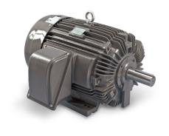
Hardware Limit Timer
Hardware Monitoring & Fault Detection
Hardware Limit Timer (HLT)
  Hardware monitoring for missed periodic events and fault detection (stalls, stops, etc.)
  Period timer with external reset input
  Flexible design
    Selectable start of event trigger
    Multiple modes
    Seven available clock sources
  Resolution of ¼ instruction cycle
  Useable as a general purpose 8-bit timer/counter with external reset capabilities
Benefits
  Reduces code complexity
    No code for detection set-up
    No code to manage timer
  Core independent operation
  Operation while in low-power SLEEP
Example Uses
  Safety limit in closed-loop control applications
    Power supplies
    Motor driver
HLT
PWM
FET Drivers
Hall Effect Sensor
Example: Monitoring a motor for fault conditions
Notes:
24
24

Slide 25
Signal Measurement Timer
24-bit Measurement of any Digital Signal
24-bit Signal Measurement Timer (SMT)
  Accurate measurement of any digital signal
    Period, pulse width, frequency, duration, duty cycle, time of flight, etc.
  High resolution 24-bit signal measurement
  Provides relative timing measurements
  Multiple interrupt sources
    Period match, measure period, pulse width
    (2) Data Capture interrupts
  Flexible input sources
  Useable as a general-purpose 24-bit timer
  Useable as a custom digital protocol decoder
Benefits
  Code-size reduction
  Faster response to changing inputs
  Core-independent operation
  Operation while in low-power SLEEP
Example Uses
  Precise speed control
  RPM indicators, sensors
  Range finding
  Protocol decode
SMT
Signal Measurement
Source Signal
Clock
Notes:
25
25

Slide 26
Peripheral Pin Select
I/O Pin Remapping of Digital Signals
Peripheral Pin Select (PPS)
  Configure any digital peripheral to any I/O pin
  Provides increased freedom & optimized use of integrated digital resources
  Flexible pin function assignment
  Route peripheral to multiple pins, to increase current drive
  Runtime configuration of pin out
Benefits
  Eliminates “pin overlap” for total optimization of peripheral resources
  Simplified and optimized migration
  Provides layout flexibility
Example Uses
  Systems requiring highest signal integrity
  Migration of legacy designs
  Support for new pin-out configurations
  Applications that require optimized tracing & board-space usage
PIC® Microcontroller
V_{DD}
V_{ss}
PPS
Digital Peripherals
Notes:
This new implementation of PPS allows for any digital peripheral to be mapped to any digital pin. This provides increased freedom and optimization of the integrated peripheral resources that designers use in their application. So whether it’s avoiding “pin overlap” (especially in 14-, 20- and 28-pins), ensuring PCB traces for highest signal integrity, or to solve space constrained issues, PPS provides significant board level flexibility and freedom to end equipment designers.
In addition, Microchip is known for giving long term life and flexibility for MIGRATION to our customers. In the past, we’ve provided pin compatibility via dedicated pin configurations for simplified/easy migration. Now our legacy customers can choose to utilize the historical pin configuration OR choose a new, more optimized pin configuration via PPS.

Slide 27
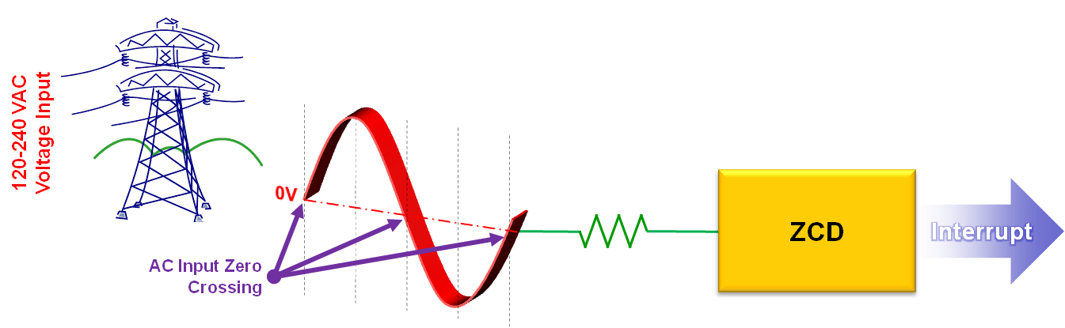
Zero Cross Detect
High-Voltage AC Zero Crossing Detection
Zero Cross Detect (ZCD)
Senses when High-Voltage AC signal on pin crosses through ground
  Pin is held at constant safe voltage
  No additional transient protection required
Indicates positive or negative phase
Generates interrupt on zero cross
Sets register flag on zero cross
Can be used to determine AC line frequency
Flexible interconnectivity with internal peripherals
Benefits
  TRIAC control
  Synchronized switching of relays
  Reduces external components
  Minimizes PCB real estate
  Core-independent operation
  Operation while in low-power SLEEP
Example Uses
  AC Power Supplies
  Timing Control
  White Goods
    TRIAC Control
  TRIAC Dimming

Slide 28
High-Endurance Flash
Non-Volatile Data Storage without EEPROM
High-Endurance Flash (HEF)
  128B of non-volatile data memory
  Shared with Flash program memory
  100k E/W cycle high endurance Flash
Benefits
  Provides non-volatile data storage
  Low cost alternative to EEPROM
  Robust data storage & durability
Example Uses
  Data logging
  Look-up tables
  Configuration & calibration settings
PIC® Microcontroller
Flash Program Memory
HEF
Writes
Reads
Non-volatile Application Data

